Slide 1
Applet code

Slide 2
AdditionApplet.java
1 // Fig. 3.12: AdditionApplet.java
2 // Adding two floating-point numbers.
3
4 // Java core packages
import java.awt.Graphics;
// import class Graphics
6
7 // Java extension packages
8 import javax.swing.*;
9
public class AdditionApplet
extends JApplet {
11 double sum;
12
// initialize applet
//by obtaining values from user
14 public void init()
15 {
16 String firstNumber; // first string entered by user
17 String secondNumber; // second string entered
18 double number1; // first number to add
19 double number2; // second number to add
20
21 // obtain first number from user
22 firstNumber = JOptionPane.showInputDialog(
23 "Enter first floating-point value" );
24
25 // obtain second number from user
26 secondNumber = JOptionPane.showInputDialog(
27 "Enter second floating-point value" );
28
29 // convert numbers from type String to type double
30 number1 = Double.parseDouble( firstNumber );
31 number2 = Double.parseDouble( secondNumber );
32

Slide 3
AdditionApplet.java
33 // add numbers
34 sum = number1 + number2;
35 }
36
37 // draw results in a rectangle
38 public void paint( Graphics g )
39 {
40 // call inherited version paint
41 super.paint( g );
43 // draw rectangle starting from (15, 10) that is 270
44 // pixels wide and 20 pixels tall
45 g.drawRect( 15, 10, 270, 20 );
46
47 // draw results as a String at (25, 25)
48 g.drawString( "The sum is " + sum, 25, 25 );
49 } // end method paint
51 } // end class AdditionApplet

Slide 4
<html>
<applet code = "WelcomeLines.class" width = "300" height = "40">
</applet>
</html>

Slide 5
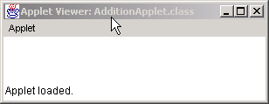
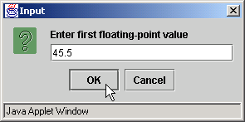
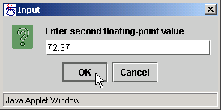
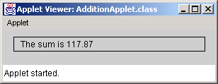
Program Output

Slide 6
More examples
import java.applet.*; import java.awt.*;
public class DrawingLines extends Applet {
int width, height;
public void init()
{ width = getSize().width;
height = getSize().height;
setBackground( Color.black );
}
public void paint( Graphics g )
{ g.setColor( Color.green );
for ( int i = 0; i < 10; ++i )
{
g.drawLine( width, height, i * width / 10, 0 );
} }}

Slide 7
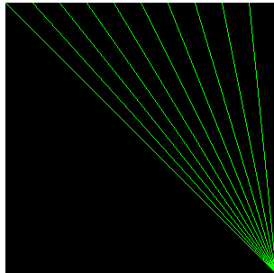

Slide 8
Example: Simple Whiteboard
import java.applet.Applet;
import java.awt.*;
import java.awt.event.*;
public class SimpleWhiteboard extends Applet {
protected int lastX=0, lastY=0;
public void init() {
setBackground(Color.white);
setForeground(Color.blue);
addMouseListener(new PositionRecorder());
addMouseMotionListener(new LineDrawer());
}
protected void record(int x, int y) {
lastX = x; lastY = y;
}

Slide 9
Simple Whiteboard (Continued)
private class PositionRecorder extends MouseAdapter {
public void mouseEntered(MouseEvent event) {
requestFocus(); // Plan ahead for typing
record(event.getX(), event.getY());
}
public void mousePressed(MouseEvent event) {
record(event.getX(), event.getY());
}
}
...

Slide 10
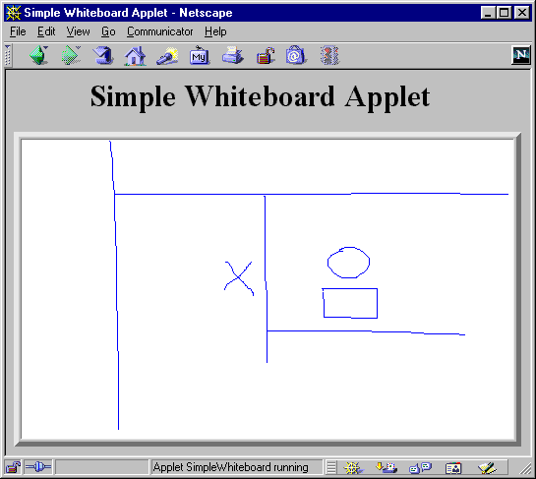
Simple Whiteboard (Continued)
...
private class LineDrawer extends MouseMotionAdapter {
public void mouseDragged(MouseEvent event) {
int x = event.getX();
int y = event.getY();
Graphics g = getGraphics();
g.drawLine(lastX, lastY, x, y);
record(x, y);
}
}
}

Slide 11
Whiteboard: Adding Keyboard Events
import java.applet.Applet;
import java.awt.*;
import java.awt.event.*;
public class Whiteboard extends SimpleWhiteboard {
protected FontMetrics fm;
public void init() {
super.init();
Font font = new Font("Serif", Font.BOLD, 20);
setFont(font);
fm = getFontMetrics(font);
addKeyListener(new CharDrawer());
}

Slide 12
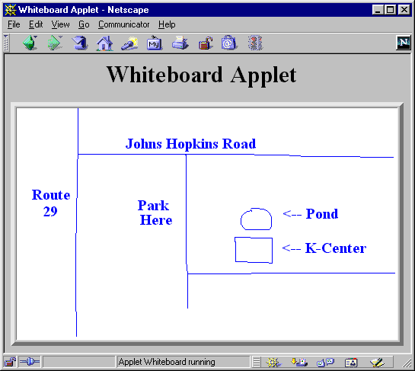
Whiteboard (Continued)
...
private class CharDrawer extends KeyAdapter {
// When user types a printable character,
// draw it and shift position rightwards.
public void keyTyped(KeyEvent event) {
String s = String.valueOf(event.getKeyChar());
getGraphics().drawString(s, lastX, lastY);
record(lastX + fm.stringWidth(s), lastY);
}
}
}

